Slide 1
FXPA Webinar: “CFTC’s SEF Reform Rule: Key Aspects & Prognosis” Presented by Justin Slaughter, Managing Partner, Mercury Strategies, and Counsel to FXPA
December 11, 2018

Slide 2
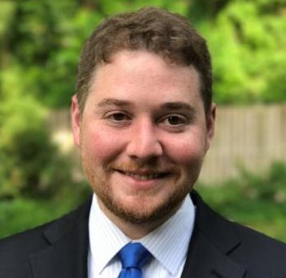
PRESENTER
Justin Slaughter
Managing Partner, Mercury Strategies
Counsel to FXPA

Slide 3
Background
History of the CFTC’s SEF Rulemaking
Permanent Registration in 2016
The Role of Chairman Chris Giancarlo
The Proposed Rulemaking Itself:
Rule Text Available at https://www.cftc.gov/sites/default/files/2018-11/federalregister110518b.pdf

Slide 4
Changes to Sef Trading
End of Order Book/RFQ Requirements
Made Available to Trade Process Going Away
Increased Discretion for Trade Facilitating and Execution
More Prohibitions on Pre-Trade Communications off SEF
End of Current Impartial Access Requirements and Mandatory All-to-All Orientation

Slide 5
Changes to SEF management
Single Dealer Aggregation Platforms
Individual Access Fees May Now Be Negotiated by SEF
Reduced Required Automatic Surveillance
Disciplinary Requirements Altered
Changes to Current Guidance on Preventing Manipulation
Straight-Through Processing Reaffirmed

Slide 6
Other Major changes
Increased Registration Requirements for Swap Broking Entities, Especially IDBs
New Swap Trading Specialist Registration Class
Foreign Swaps Brokers
Change to Immediate Trade Confirmation Requirement
Additional SEF Registration Process Changes

Slide 7
Impact of this Rulemaking and its Reception thus far
Broad Increase in Entities Required to Register
Three Main Goals Underlying this Rulemaking
Response Thus Far
Industry
Other Commissioners
Lawmakers

Slide 8
Prognosis for this Rulemaking
Comment Period Ends February 13
Internal CFTC Process Following Comment Period
Cost-Benefit Issues
Chairman Giancarlo’s Announced Plans
Potential Finalization in Fall 2019
Compliance Delays
X Factors

Slide 9
Q&A
Justin Slaughter
jslaughter@mercurystrategies.com
+1 404-558-2002

Slide 10
For More Information:
Please visit:
www.fxpa.org for additional information about the Foreign Exchange Professionals Association (FXPA)

